Slide 1
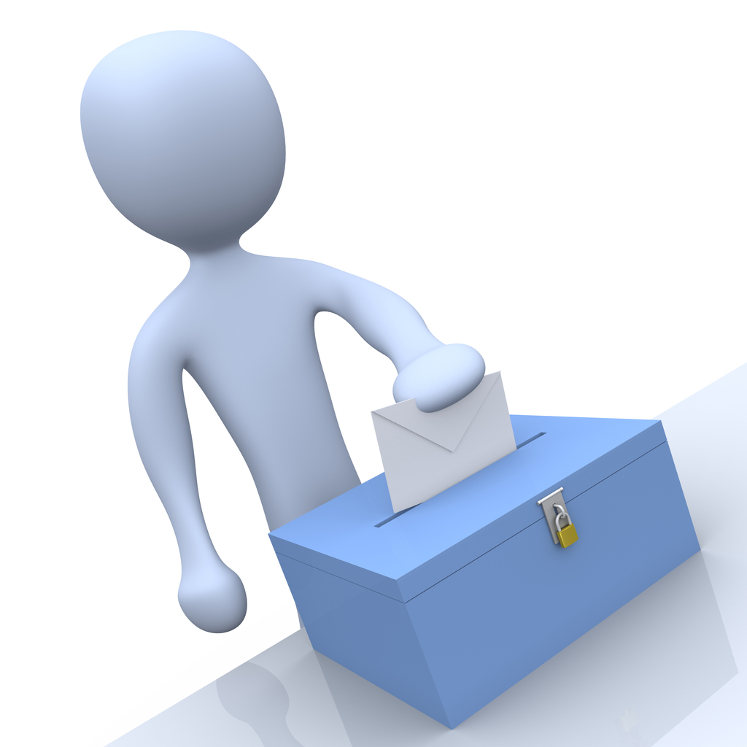
E-Voting
Blockchain

Slide 2
It is enough that the people know there was an election.
The one who cast the votes decide nothing.
The one who count the votes decide everything.
Joseph Stalin

Slide 3
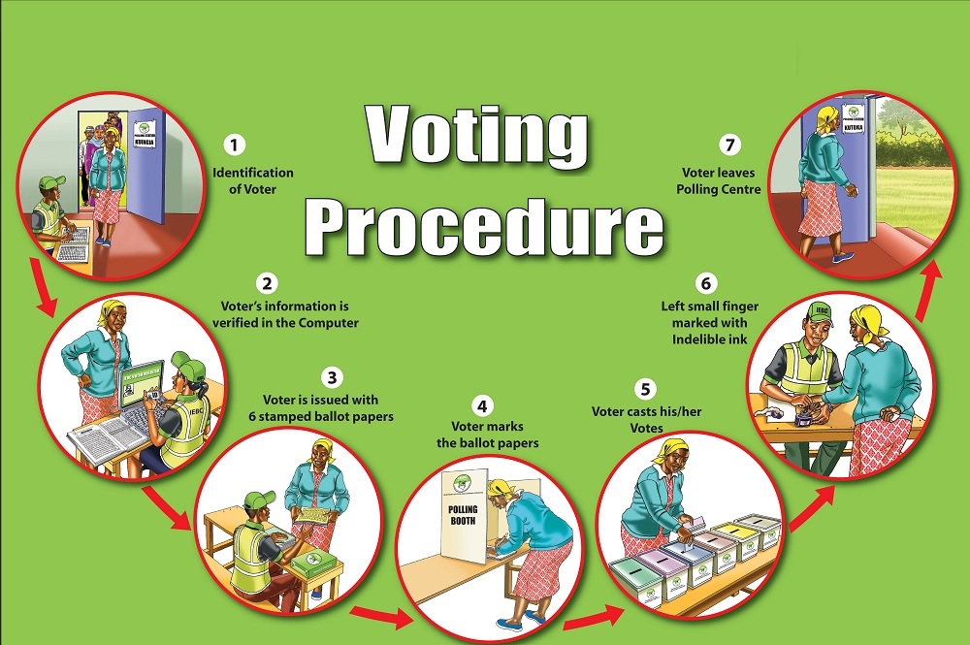
Traditional Voting Process

Slide 4
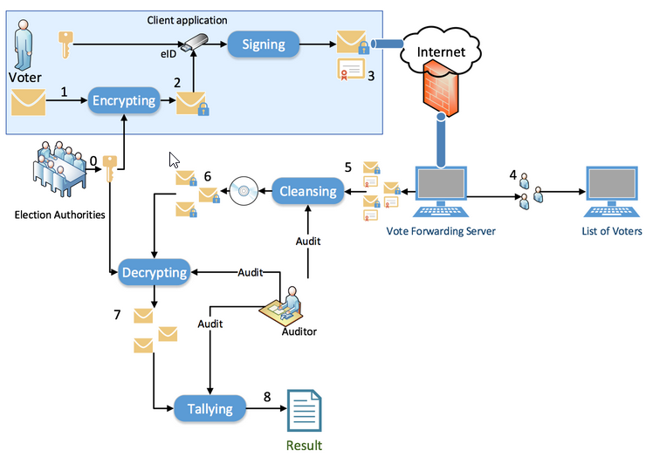
Current Online Voting Process

Slide 5
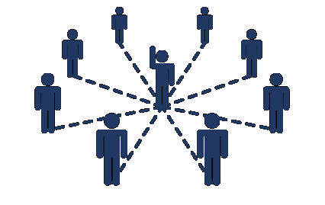
Problem
Third-party
Result
Reliability
Integrity
Votes count
Anonymity
Voters identity
Crash Database

Slide 6
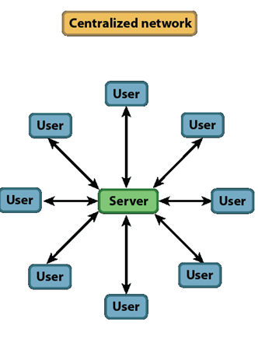
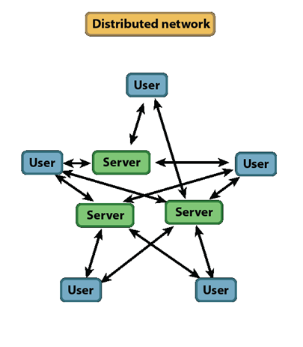
Solution

Slide 7
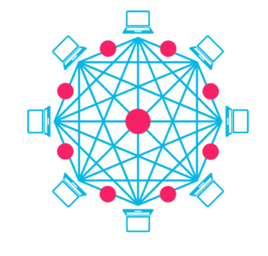
Blockchain Technology
A distributed database
Shared and immutable database
Blockchain Durability and robustness
The blockchain cannot:
Be controlled by any single entity.
Has no single point of failure.

Slide 8
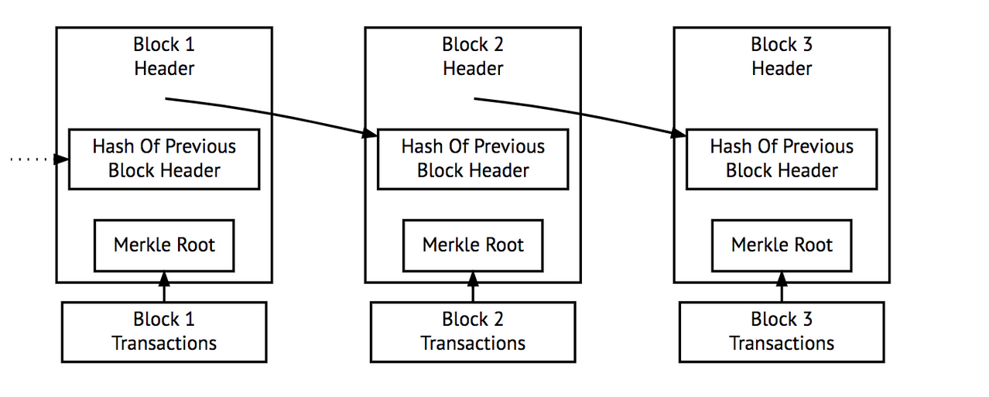
Blockchain Technology
Hashed
Hashed
Hashed
Block 1
Data
Block 2
Data
Block 3
Data

Slide 9
Why using Blockchain for Online Voting?
When the result is released, voters can see each other votes but not their identity.
Since it is impossible to change the data in the blockchain without voters knowledge, integrity is ensured.
Only the legitimate ballots are counted makes the result reliable.
When a voter joins the network, it would be broadcasted to the network to verify the voter. This makes there is no clone vote in the system.
The database is recoverable since there are at least 2 nodes remain.

Slide 10
Comparison
 | Papers | Server-Client | Blockchain
Advantages | Tradition – Easy to use. Easy to control. | High performance. Confidentiality. | Trust. Robustness. Integrity.
Disadvantage | Waste of time and money. Rely on Third-party. | Rely on Third-party. | Low performance. Human Behavior. Size of network.

Slide 11
Voting Blockchain
Scope:
Internal Bosch, at least 10 nodes work in the network.
Challenge:
Voting:
How to control One-Person-One-Account.
How to verify the eligible account in order to join to the polling.
What voters can see during and after the polling.
Technical:
Technical explanation.
Read the data from encrypted blocks.
Function to calculate the result.

Slide 12
Block in Voting system
All the ballot occur in 5 minutes will be collected and put into 1 block, which has:
Hashed address: A hash will be generated after 5 minutes, include all data contain in the block: time submit, transactions.
Time submit: The time when the block was created.
Transactions: It is modified to store the information of a ballot (Hashed address of the voters, their answer for the polling, time they submit their ballots).
Hashed address of previous block: Link to the previous block in the chain.
Hash(Address of a block)
Time submit
Hash(User 1 - ID)
Detail of the vote Question 1 – Answer
Question 2 – Answer
…
Question n – Answer
Time
Hash(User 2 - ID)
Detail of the vote Question 1 – Answer
Question 2 – Answer
…
Question n – Answer
Time
Hash(Previous Block)

Slide 13
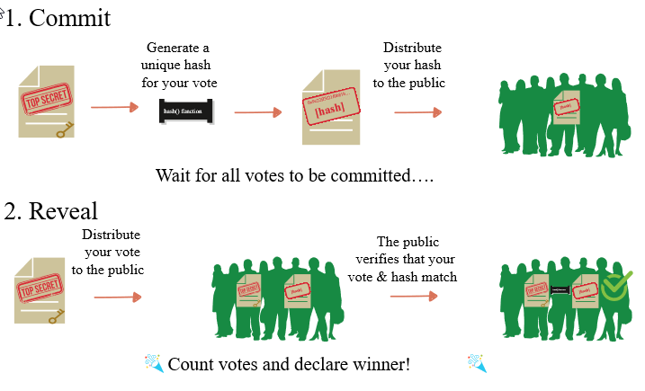
Verify and add blocks into the chain

Slide 14
Verify and add blocks into the chain
Hash(Address of a block)
Hash(Address of a block)
Hash(Address of a block)
Time submit
Time submit
Time submit
Hash(User 1 - ID)
The Polling ID
Detail of the vote Question 1 – Answer
Question 2 – Answer
…
Question n – Answer
Time
Hash(User 2 - ID)
The Polling ID
Detail of the vote Question 1 – Answer
Question 2 – Answer
…
Question n – Answer
Time
Hash(User 3 - ID)
The Polling ID
Detail of the vote Question 1 – Answer
Question 2 – Answer
…
Question n – Answer
Time
Hash(User 4 - ID)
The Polling ID
Detail of the vote Question 1 – Answer
Question 2 – Answer
…
Question n – Answer
Time
Hash(User 5 - ID)
The Polling ID
Detail of the vote Question 1 – Answer
Question 2 – Answer
…
Question n – Answer
Time
Hash(User 6 - ID)
The Polling ID
Detail of the vote Question 1 – Answer
Question 2 – Answer
…
Question n – Answer
Time
Hash(Previous Block)
Hash(Previous Block)
Hash(Previous Block)

Slide 15
Voting Blockchain Process
When a node (user) want to join in the voting network:
1: The node broadcasts to every node in the network a message: “I want to join in”
2: All the nodes will verify that there is a node want to join in, create a transaction about it and put into a block. Then the new node have to download a Public Ledger.
3: Each node in the network has a copy of the pubic ledger.
4: The new node downloads the public ledger and broadcasts to the network. The block about this transaction will be added into a chain and the network update their public ledgers.
Now, the new node joined into the network.
Node
Node
Node
1
2
Node
Node
4
Blockchain Network
3
Public
Ledger

Slide 16
Voting Blockchain Process
Blockchain Network
1: Node A want to create a polling so it broadcasts to the network.
2: The network verify the vote and put it in a block.
3: After 5 minutes, the block is hashed and add into the chain.
4: The other nodes (B, C, D, E, F,…) will cast the vote, then all of the ballot will be stored in a block as transactions.
5: When the polling meets its end condition, it will open related blocks and calculate the result. Then it broadcasts to the network the detail of the vote.
A
1
B
C
5
Public
Ledger
2
F
E
D
3
Block
4

Slide 17
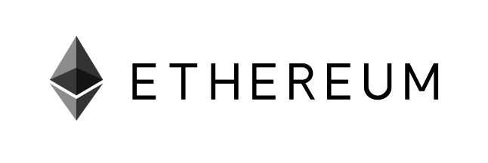



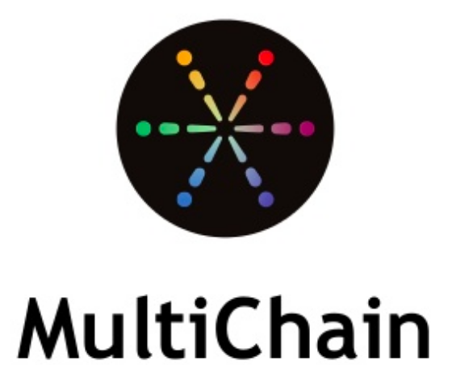


Frameworks

Slide 18
Thank for listening

Slide 19
Q&A

